Slide 1
Chapter 7:
User-Defined Simple Data Types, Namespaces, and the string Type

Slide 2
Objectives
In this chapter, you will:
  Learn how to create and manipulate your own simple data type - called the enumeration type
  Explore how the assignment statement, and arithmetic and relational operators work with enum types
  Learn how to use for loops with enum types
  Learn how to input data into an enum type
C++ Programming: Program Design Including Data Structures, Seventh Edition

Slide 3
Objectives (cont’d.)
  Learn how to output data stored in an enum type
  Explore how to write functions to process enum types
  Learn how to declare variables when defining the enumeration type
  Become familiar with anonymous types
  Become familiar with the typedef statement
C++ Programming: Program Design Including Data Structures, Seventh Edition

Slide 4
Objectives (cont’d.)
  Learn about the namespace mechanism
  Explore the string data type, and learn how to use string functions to manipulate strings
C++ Programming: Program Design Including Data Structures, Seventh Edition

Slide 5
Enumeration Type
Data type: a set of values with a set of operations on them
Enumeration type: a simple data type created by the programmer
To define an enumeration type, you need:
  A name for the data type
  A set of values for the data type
  A set of operations on the values
C++ Programming: Program Design Including Data Structures, Seventh Edition
Notes:
By providing data types, you specify what values are legal and tell the user what kinds of operations are allowed on those values. The system thus provides you with built-in checks against errors.
The data types that you have worked with until now were mostly int, bool, char, and double. Even though these data types are sufficient to solve just about any problem, situations occur when these data types are not adequate to solve a particular problem. C++ provides a mechanism for users to create their own data types, which greatly enhances the flexibility of the programming language.
Tonight you will learn how to create your own simple data types, known as the enumeration types.

Slide 6

Enumeration Type (cont’d.)
You can specify the name and the values, but not the operations
Syntax:
  value1, value2, … are identifiers called enumerators
  List specifies the ordering:
    value1 < value2 < value3 <...
C++ Programming: Program Design Including Data Structures, Seventh Edition

Slide 7
Enumeration Type (cont’d.)
The enumeration type is an ordered set of values
  Default value assigned to enumerators starts at 0
A value used in one enumeration type cannot be used by another in same block
Same rules apply to enumeration types declared outside of any blocks
C++ Programming: Program Design Including Data Structures, Seventh Edition

Slide 8
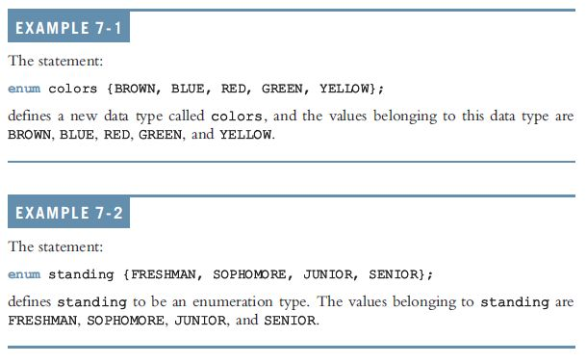
Enumeration Type (cont’d.)
C++ Programming: Program Design Including Data Structures, Seventh Edition

Slide 9
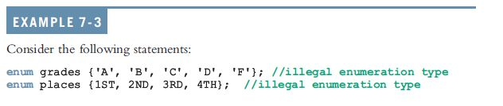
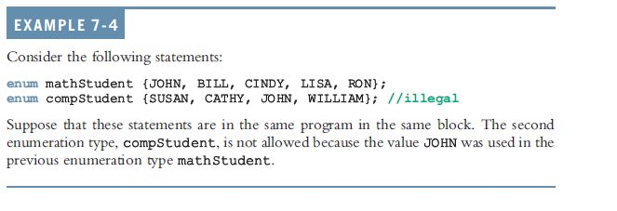
Enumeration Type (cont’d.)
C++ Programming: Program Design Including Data Structures, Seventh Edition
Notes:
Enumeration type in C++ is an integral type. This will help clarify some of the syntax requirements in later sections.
Fundamental types in C++ are divided into three categories: integral, floating point, and void. Integral types are capable of handling whole numbers.

Slide 10

Declaring Variables
The Syntax for declaring the variable type enum:
The Statement example:
  Can declare variables such as:
C++ Programming: Program Design Including Data Structures, Seventh Edition
Notes:
Once a data type is defined, you can declare variables of that type. The syntax for declaring variables of an enum type is the same as before:

Slide 11
Assignment
Once a variable is declared, you can store values in it.
Values can be stored in enumeration data types:
popularSport = FOOTBALL;
  Stores FOOTBALL into popularSport
C++ Programming: Program Design Including Data Structures, Seventh Edition

Slide 12

Operations on Enumeration Types
Arithmetic operations not allowed on enumeration types
++ and -- are illegal, too:
Solution: use a static cast
C++ Programming: Program Design Including Data Structures, Seventh Edition
Notes:
Also, the increment and decrement operations are not allowed on enumeration types.
So the following statements are illegal:
Suppose you want to increment the value of popularSport by . You can use the cast operator as follows:

Slide 13

Relational Operators
An enumeration type is an ordered set of values:
An enumeration type is an integral data type and can be used in loops:
C++ Programming: Program Design Including Data Structures, Seventh Edition
Notes:
Because an enumeration is an ordered set of values, the relational operators can be used with the enumeration type. Once again, suppose you have the enumeration typesports and the variables popularSport and mySport as defined earlier.
Relational Operators:
There are following relational operators supported by C++ language
Assume variable A holds 10 and variable B holds 20, then:
Show Examples
Operator Description Example == Checks if the values of two operands are equal or not, if yes then condition becomes true.(A == B) is not true.!=
Checks if the values of two operands are equal or not, if values are not equal then condition becomes true.
Recall that the enumeration type is an integral type and that, using the cast operator (that is, type name), you can increment, decrement, and compare the values of the enumeration type. Therefore, you can use these enumeration types in loops. SupposemySport is a variable as declared earlier. Consider the following for loop:

Slide 14
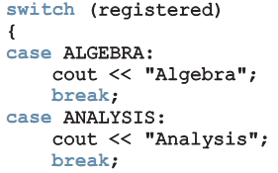
Input /Output of Enumeration Types
An enumeration type cannot be input/output (directly)
  Can input and output indirectly
C++ Programming: Program Design Including Data Structures, Seventh Edition
Notes:
Because input and output are defined only for built-in data types such as int, char,double, and so on, the enumeration type can be neither input nor output (directly). However, you can input and output enumeration indirectly.

Slide 15
Functions and Enumeration Types
Enumeration types can be passed as parameters to functions either by value or by reference
A function can return a value of the enumeration type
C++ Programming: Program Design Including Data Structures, Seventh Edition

Slide 16
Declaring Variables When Defining the Enumeration Type
Can declare variables of an enumeration type when you define an enumeration type:
C++ Programming: Program Design Including Data Structures, Seventh Edition
Notes:
Defines an enumeration type, grades, and declares a variable courseGrade of typegrades.

Slide 17
Anonymous Data Types
Anonymous type: values are directly specified in the declaration, with no type name
Example:
C++ Programming: Program Design Including Data Structures, Seventh Edition
Notes:
A data type wherein you directly specify values in the variable declaration with no type name is called an anonymous type. The following statement creates an anonymous type:
This statement specifies the values and declares a variable mySport, but no name is given to the data type.

Slide 18
Anonymous Data Types (cont’d.)
Drawbacks:
  Cannot pass/return an anonymous type to/from a function
  Values used in one type can be used in another, but are treated differently:
Best practices: to avoid confusion, define an enumeration type first, then declare variables
C++ Programming: Program Design Including Data Structures, Seventh Edition
Notes:
Creating an anonymous type, however, has drawbacks. First, because there is no name for the type, you cannot pass an anonymous type as a parameter to a function, and a function cannot return an anonymous type value. Second, values used in one anonymous type can be used in another anonymous type, but variables of those types are treated differently.

Slide 19

typedef Statement
typedef statement: used to create synonyms or aliases to a data type
Syntax:
typedef does not create any new data types
  Only creates an alias to an existing data type
C++ Programming: Program Design Including Data Structures, Seventh Edition
Notes:
In C++, you can create synonyms or aliases to a previously defined data type by using the typedef statement. The general syntax of the typedef statement is:

Slide 20
Namespaces
ANSI/ISO standard C++ was officially approved in July 1998
Most recent compilers are compatible with ANSI/ISO standard C++
For the most part, standard C++ and ANSI/ISO standard C++ are the same
  However, ANSI/ISO Standard C++ has some features not available in Standard C++
C++ Programming: Program Design Including Data Structures, Seventh Edition
Notes:
When a header file, such as iostream, is included in a program, the global identifiers in the header file also become the global identifiers in the program. Therefore, if a global identifier in a program has the same name as one of the global identifiers in the header file, the compiler generates a syntax error (such as “identifier redefined”). The same problem can occur if a program uses third-party libraries.

Slide 21
Namespaces (cont’d.)
Global identifiers in a header file used in a program become global in the program
  Syntax error occurs if a program’s identifier has same name as a global identifier in the header file
Same problem can occur with third-party libraries
  Common solution: third-party vendors begin their global identifiers with _ (underscore)
    Do not begin identifiers in your program with _
C++ Programming: Program Design Including Data Structures, Seventh Edition

Slide 22
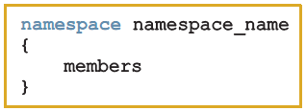
Namespaces (cont’d.)
ANSI/ISO Standard C++ attempts to solve this problem with the namespace mechanism
Syntax:
  Where members consist of variable declarations, named constants, functions, or another namespace
C++ Programming: Program Design Including Data Structures, Seventh Edition

Slide 23
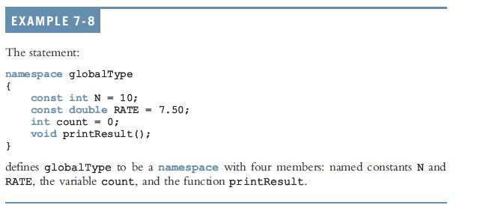
Namespaces (cont’d.)
C++ Programming: Program Design Including Data Structures, Seventh Edition

Slide 24



Namespaces (cont’d.)
A namespace member has scope local to the namespace
A namespace member can be accessed outside the namespace:
C++ Programming: Program Design Including Data Structures, Seventh Edition

Slide 25
Namespaces (cont’d.)
Examples:
globalType::RATE
using namespace globalType::printResult();
using globalType::RATE;
After the using statement, it is not necessary to put the namespace_name:: before the namespace member
  Unless a namespace member and a global identifier or a block identifier have the same name
C++ Programming: Program Design Including Data Structures, Seventh Edition

Slide 26
string Type
To use data type string, a program must include the header file string
A string is a sequence of 0 or more characters
  The first character is in position 0
  The second character is in position 1, etc.
Binary operator + performs the string concatenation operation
Array subscript operator [] allows access to an individual character in a string
C++ Programming: Program Design Including Data Structures, Seventh Edition
Notes:
The data type string is a programmer-defined type and is not part of the C++ language; the C++ standard library supplies it. Before using the data type string, the program must include the header file string, as follows:

Slide 27
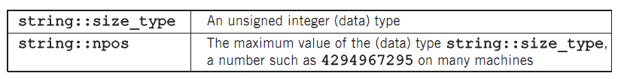
Additional string Operations
C++ Programming: Program Design Including Data Structures, Seventh Edition

Slide 28
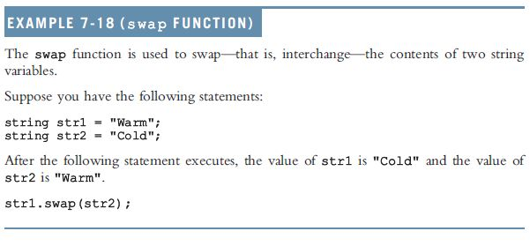
Example 7-18: swap Function
C++ Programming: Program Design Including Data Structures, Seventh Edition

Slide 29
Summary
Enumeration type: set of ordered values
  Reserved word enum creates an enumeration type
No arithmetic operations are allowed on the enumeration type
Relational operators can be used with enum values
Enumeration type values cannot be input or output directly
Enumeration types can be passed as parameters to functions by value or by reference
C++ Programming: Program Design Including Data Structures, Seventh Edition

Slide 30
Summary (cont’d.)
Anonymous type: a variable’s values are specified without any type name
Reserved word typedef creates synonyms or aliases to previously defined data types
The namespace mechanism is a feature of ANSI/ISO Standard C++
A namespace member is usually a named constant, variable, function, or another namespace
Scope of a namespace member is local to namespace
C++ Programming: Program Design Including Data Structures, Seventh Edition

Slide 31
Summary (cont’d.)
using statement simplifies access to namespace members
A string is a sequence of 0 or more characters
Strings in C++ are enclosed in ""
First character of a string is in position 0
In C++, [] is the array subscript operator
C++ Programming: Program Design Including Data Structures, Seventh Edition

